Slide 1
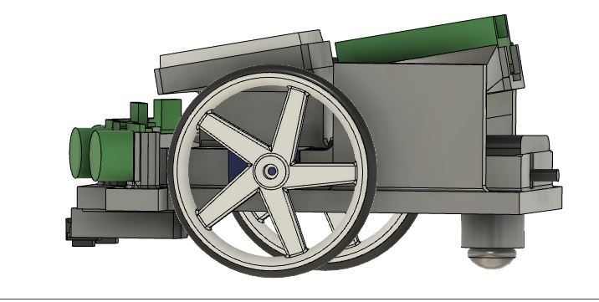
Chassis revision and production
Presentered by Hasinu Ravishka

Slide 2
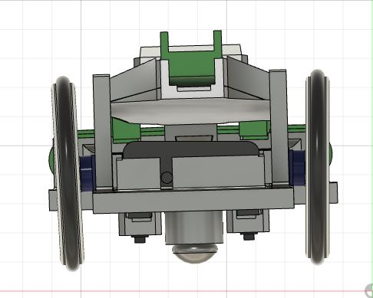
Back view
Tools
create sketch
extrude
loft
mirror
fillet
joint
construct
supports
microcontroller suport
battery holder

Slide 3
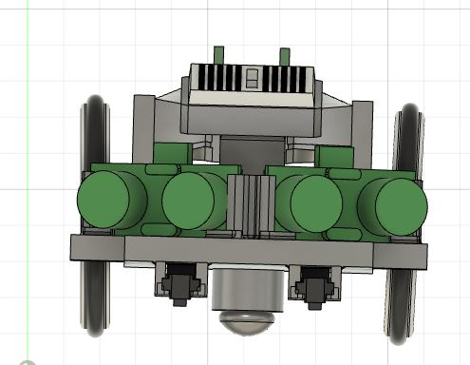
Front view
Tools
create sketch
extrude
loft
mirror
fillet
joint
construct
joint
new body
supports
ultrasonic sensor holder
ground sensor holder
bread board holder

Slide 4
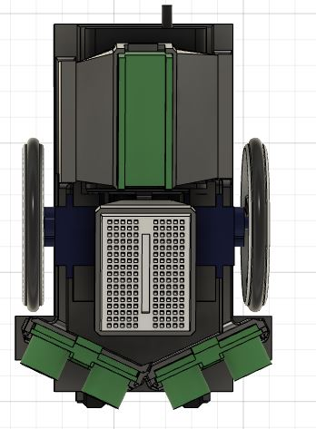
Top view
length
141mm
width -
94mm

Slide 5
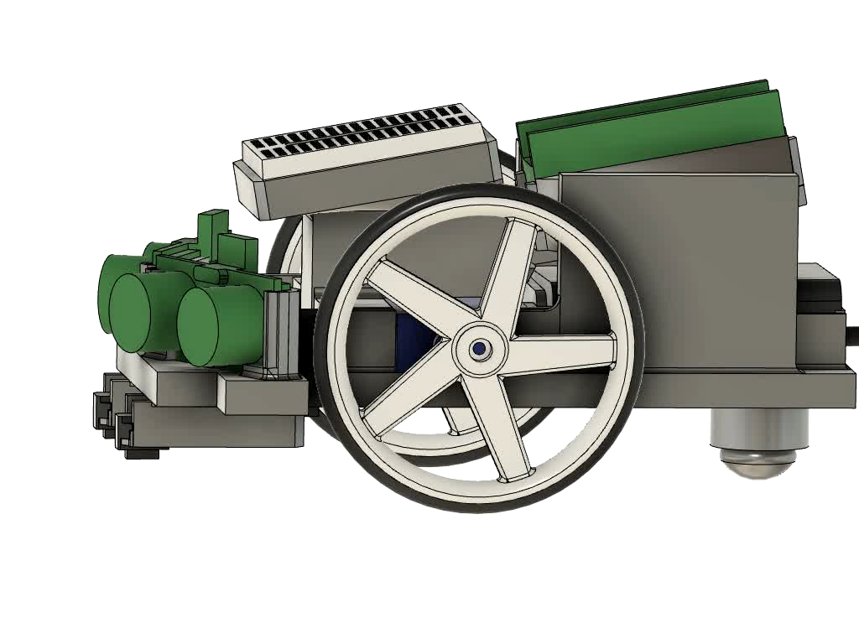
Left side

Slide 6
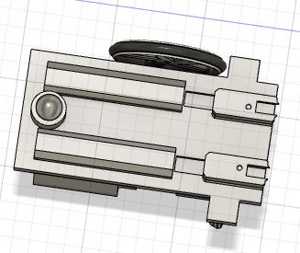
bottom
Chassis supporter for bottom
ground sensor holder
tunnel for ground sensor

Slide 7
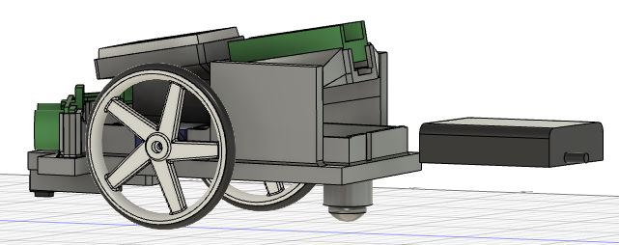
Move battery pack
AAA Battery Holder type it is suitable for maintenance of all kinds of dc equipment.Easy to Install the battery is fixed by a stainless steel spring.It is very convenient to install and replace the battery, and it is not easy to damage.
width - 46.70mm
length - 38.70mm
thin - 2.5mm

Slide 8
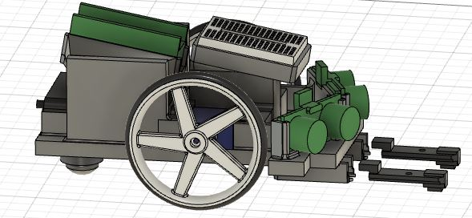
Move ground sensors
An infrared reflectance sensor forms the basis of the HW-006 (V1.3) line tracker sensor module. Typically, this is positioned at the end of a line that follows the robot chassis. This little tracking sensor module can identify items right in front of it in addition to light-to-dark line transitions.The recommended working voltage of the sensor module is 3.3V to 5V DC while its peak operating current is around 20mA to 30mA
length - 35.4mm
width - 10.65mm

Slide 9
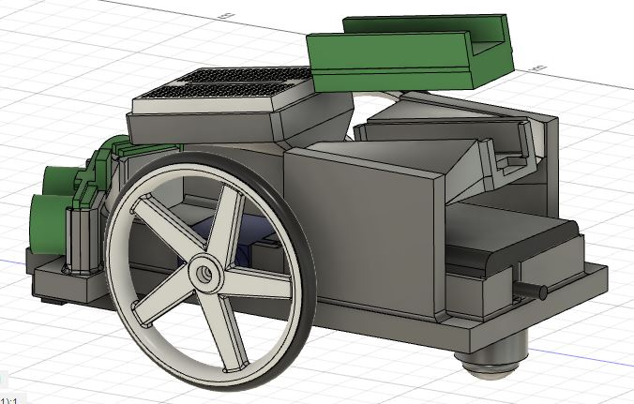
Move microcontrol
The dual-core Arm Cortex-M0+ processor in the Raspberry Pi RP2040 has 264kB of RAM built in and supports up to 16MB of off-chip flash. I2C, SPI, and - most notably - Programmable I/O (PIO) are just a few of the many configurable I/O possibilities
width - 21.08mm
length - 53.68mm
width - 48mm
height - 39mm
thin - 5.6mm

Slide 10
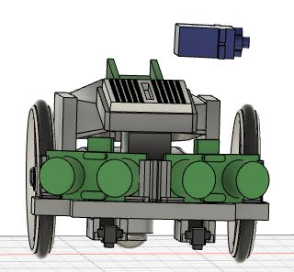
Move servo
Tools
create sketch
extrude
loft
mirror
fillet
joint
construct
joint
new body
move tool
This servo motor has a built-in 3-wire connector: just plug 3 jumper wires into the connector and then plug the other end of the jumper wires into a breadboard. To make it easier to remember which wire is which, use corresponding white, red, and black jumper wires to match the servo motor wires.f

Slide 11
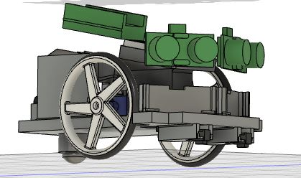
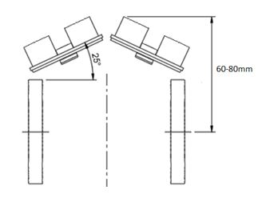
The HC-SR04 Ultrasonic Range Sensor Features:
Input Voltage: 5V
Current Draw: 20mA (Max)
Digital Output: 5V
Digital Output: 0V (Low)
Working Temperature: -15°C to 70°C
Sensing Angle: 30° Cone
Angle of Effect: 15° Cone
Ultrasonic Frequency: 40kHz
Range: 2cm - 400cm
Dimensions
Length: 43mm
Width: 20mm
Height (with transmitters): 15mm
Centre screw hole distance: 40mm x 15mm
Screw hole diameter: 1mm (M1)
Transmitter diameter: 8mm
Move ultrasonic sensor
width - 8.9mm
length - 43.50mm
height - 17.76mm

Slide 12
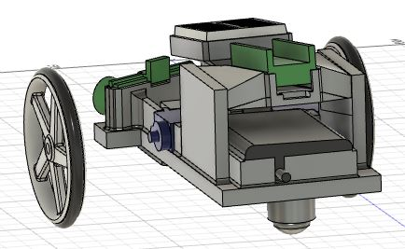
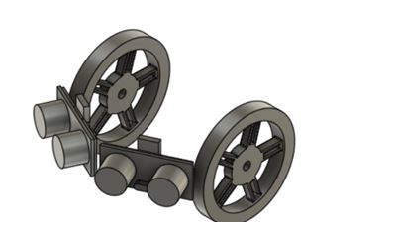
Move weel
Wheel Features:
Sturdy 5 Spoke design.
Injection moulded with matte white ABS.
The ABS used is lightweight and has very good mechanical properties .making them durable and difficult to break.
Supplied with rubber 0-rings that fit to the wheel and act as tyers.
Push fit for 3mm d-shaft motors.
The ABS wheel material is fully recyclable.
Dimensions:
Wheel Diameter (no tire): 63mm.
Wheel Diameter (with tire): 67.5mm.
Max Width: 10.9mm.

Slide 13
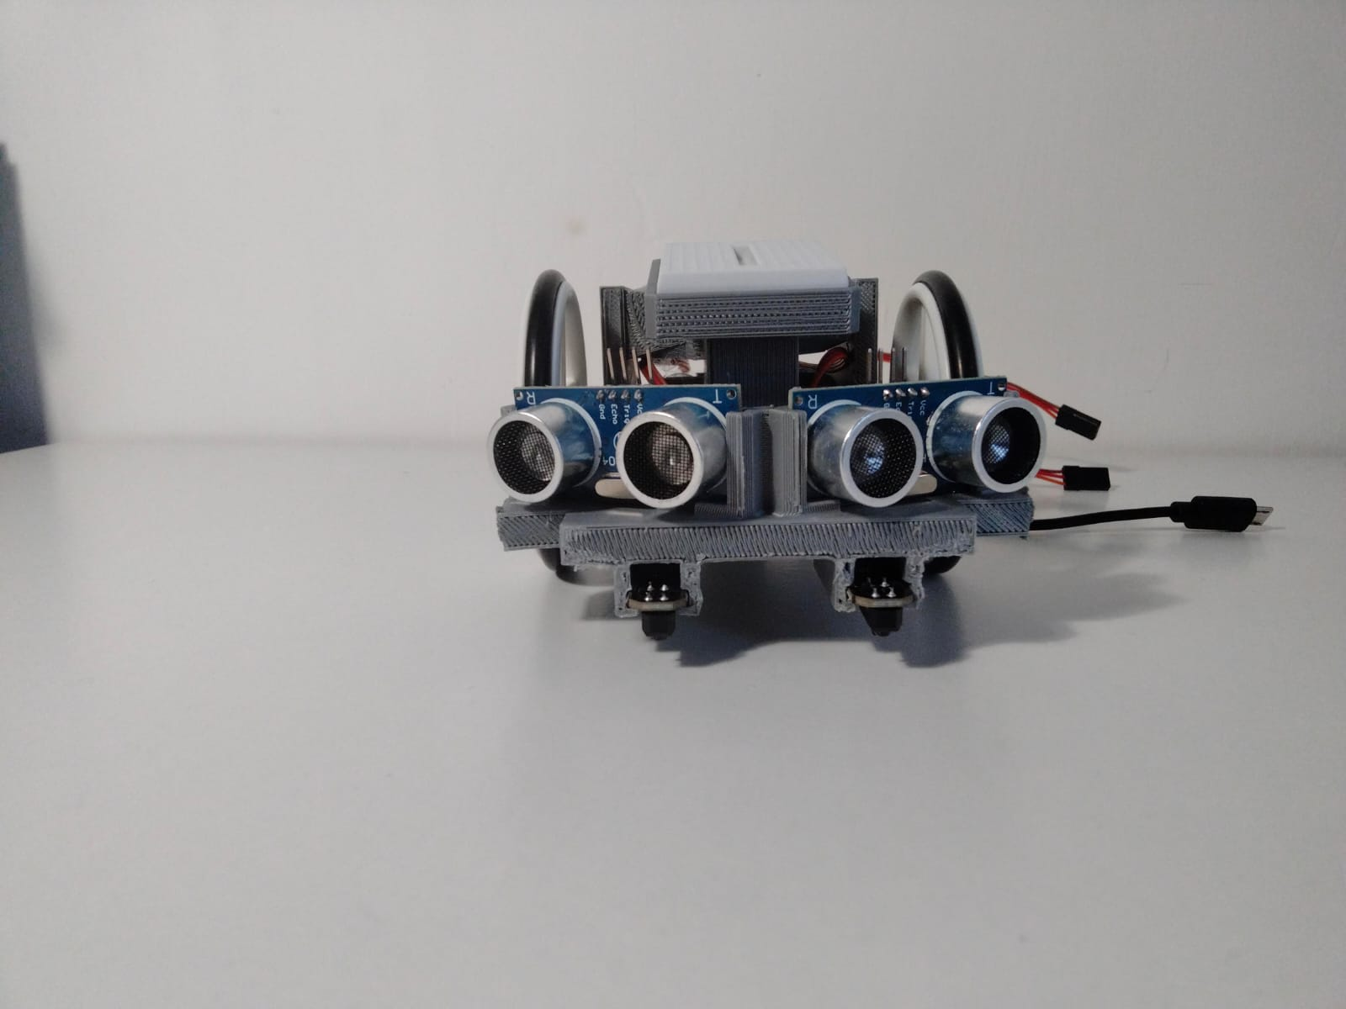
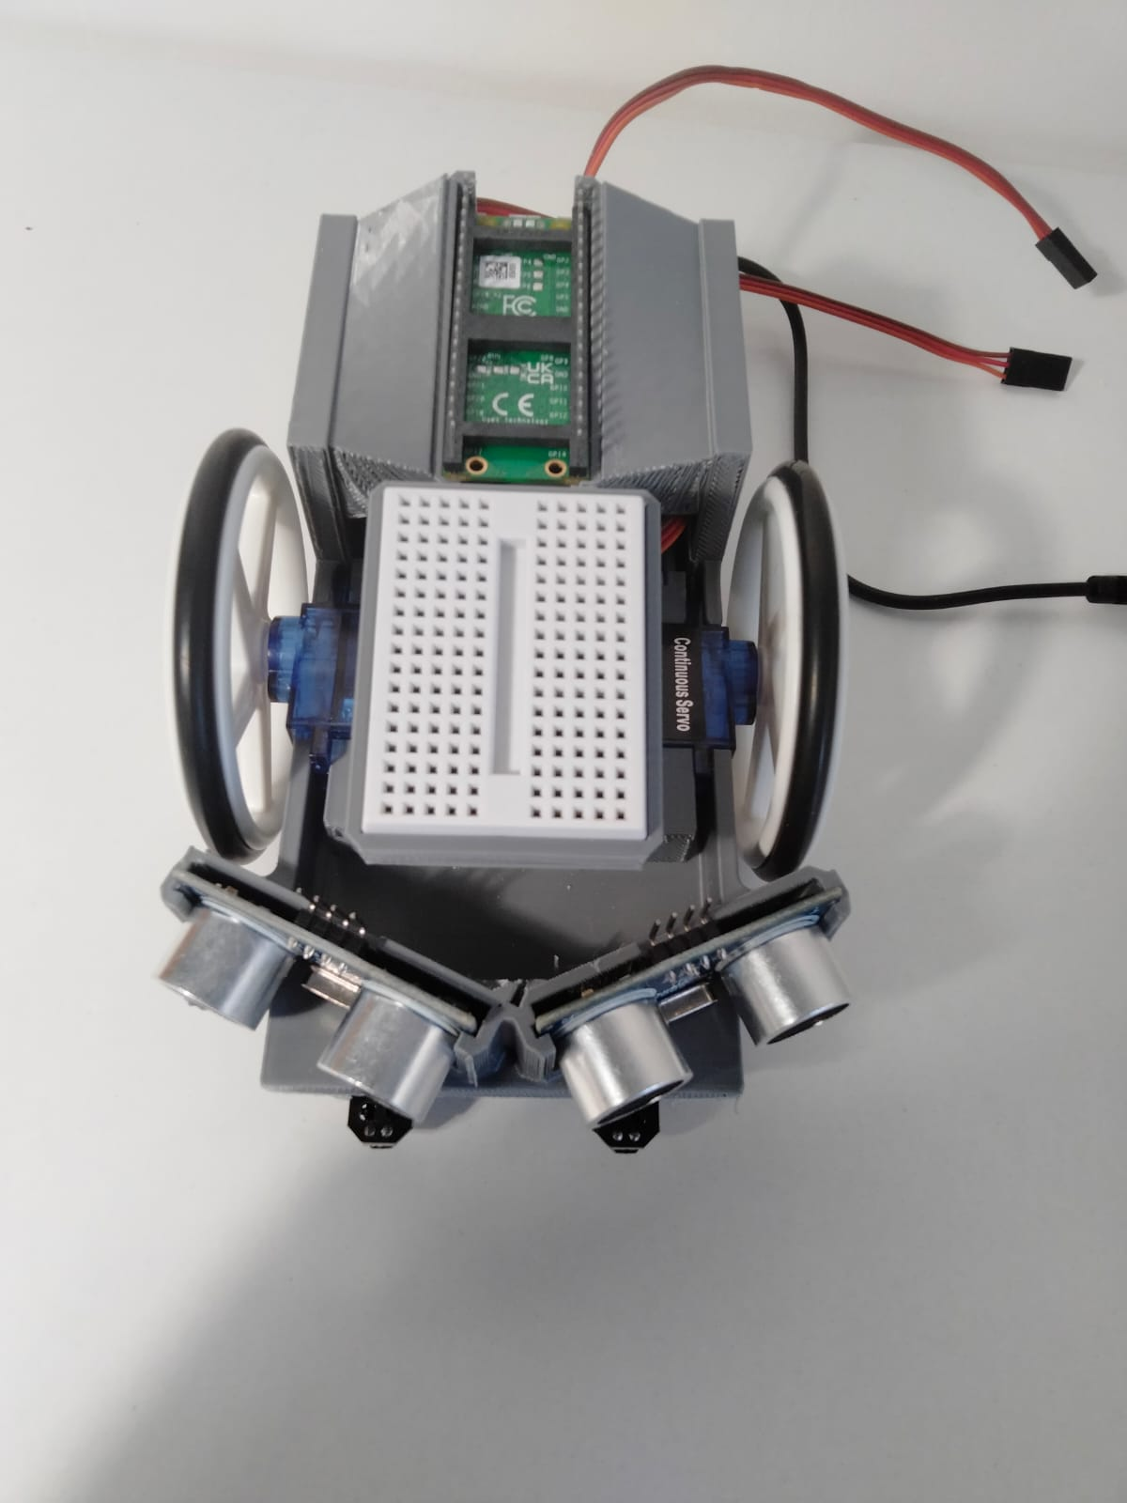
front and top

Slide 14
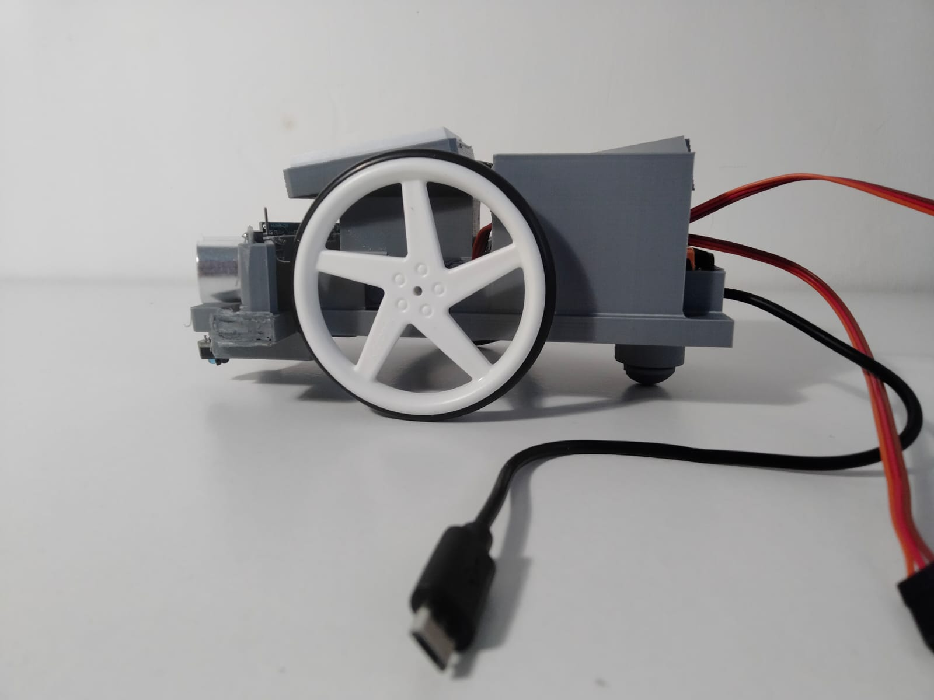
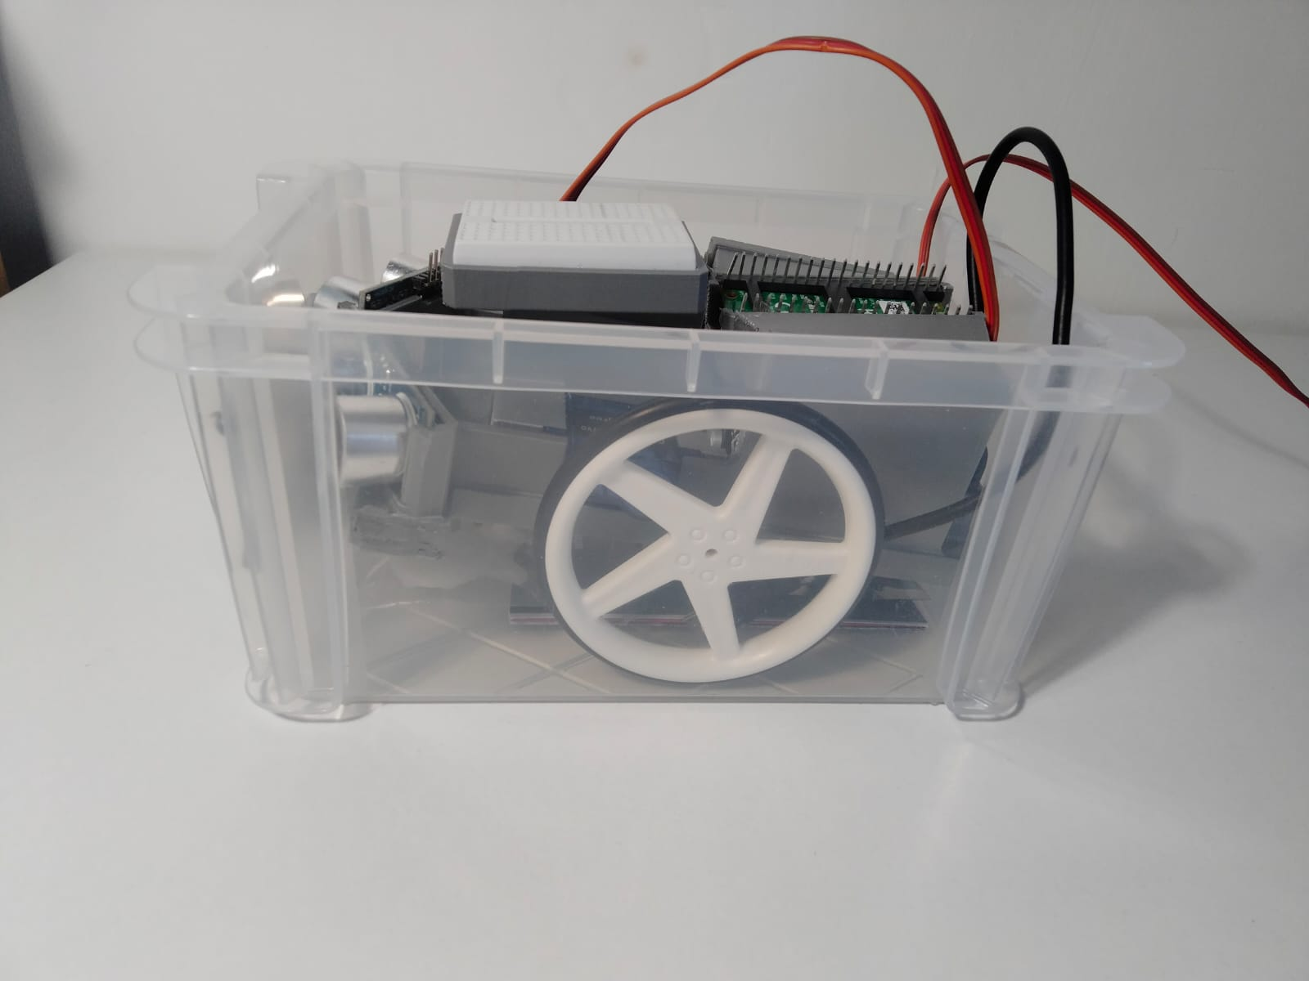
left view

Slide 15
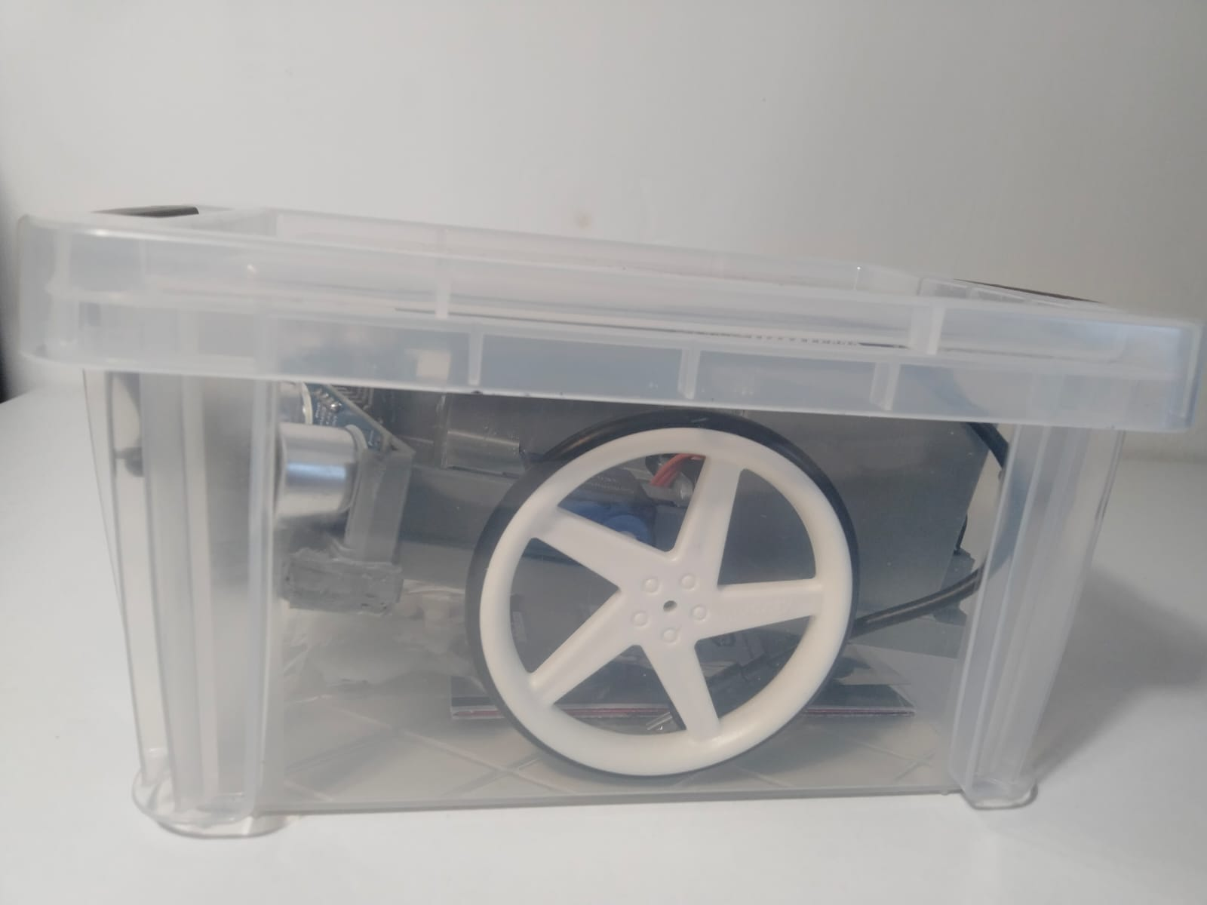
In to the box
Box length is 141.00mm
Box width is 94.00mm

Slide 16
THANK YOU
ID - 22098675

